Slide 1
Dynamic Edge Weighting in Relational Graph Convolutional Networks: Enhancing Sample Efficiency via Graph Attention in Reinforcement Learning
Committee Members
Dr Tim Oates(Chair),University of Maryland Baltimore County
Dr Tinoosh Mohsenin,John Hopkins University
Dr Manas Gaur,University of Maryland Baltimore County

Slide 2
Contents
Introduction
Background and Related Work
Methodology
Experimental Settings
Experimental Results
Conclusion
Notes:
This is how the flow of the Presentation is going to look like

Slide 3
Objective
Reduce sample complexity for policy learning in dynamic RL environments .
Integrate GATs with R-GCNs for effective relational modeling.
Implement dynamic edge weighting based on current states.
Validate performance using different Mini Grid environments.
Achieve faster convergence and better decision-making through adaptive focus on relevant connections.
Notes:
Our primary goal is to tackle the high sample complexity often encountered in dynamic reinforcement learning environments. We aim to reduce the number of interactions necessary for learning an effective policy by integrating Graph Attention Networks (GATs) with Relational Graph Convolutional Networks (R-GCN). This integration allows for dynamic edge weighting, prioritizing connections based on their relevance to the decision-making context, which increases the sample efficiency. We will validate this approach across various complex Minigrid environments to demonstrate its effectiveness and adaptability. Lastly, this research thesis contributes to the development of robust and efficient reinforcement learning systems suitable for real-world applications.

Slide 4
Introduction

Slide 5

Reinforcement Learning Overview
Reinforcement Learning (RL) is a machine learning approach that teaches agents to make decisions by interacting with the environment and receiving rewards.
Applied in robotics, self driving cars , game AI, and natural language processing.
Faces challenges like high sample complexity, requiring many interactions, costly in real-world applications.
Objective: Reduce sample complexity to make RL more feasible for practical scenarios.
Notes:
Reinforcement Learning (RL) is a type of machine learning where agents learn to make decisions by interacting with their environment and receiving feedback in the form of rewards. It has applications in **robotics**, **self-driving cars**, **game AI**, and **natural language processing**.
One major challenge RL faces is **high sample complexity**—it requires many interactions with the environment to learn effectively, which can be costly in real-world scenarios.
Our objective is to **reduce sample complexity**, making RL more practical and efficient for real-world applications in relational domains .

Slide 6
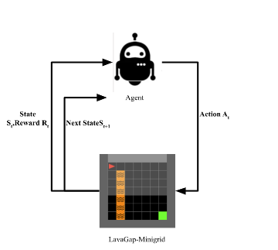
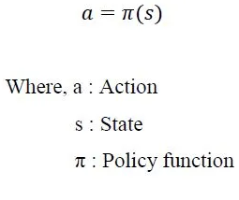
Components of Reinforcement Learning
Agent: A learner that interacts with an environment by taking actions to maximize cumulative rewards.
Environment: The external system that provides states and rewards to the agent based on its actions.
State : The observation, the agent does on the environment after performing an action
Action : An action that the agent performs on the environment based on its observation
Reward: A feedback signal that quantifies the benefit of the agent’s actions within the environment.
Model: The agent’s internal representation of the dynamics of the environment, often used for planning or decision-making.
Policy: A function or mapping that determines the actions an agent should take in given states. It can be deterministic or stochastic.

Slide 7
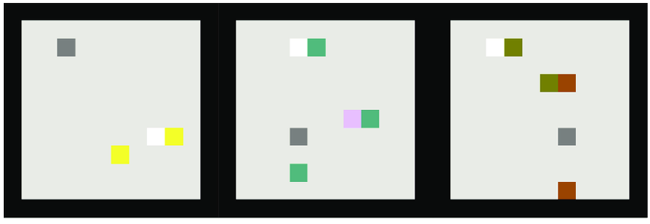
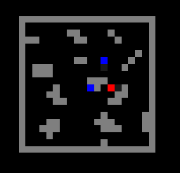
Relational Domains in RL
Examples include social networks, traffic management systems, knowledge graphs, and multi-agent environments.
Nodes represent entities (e.g., people, vehicles, or agents), and edges represent relationships or interactions (e.g., friendship, communication, spatial proximity,coordination).
Capturing the dependencies and interactions between entities is crucial for effective decision-making.
Conventional RL models struggle to handle these complex interactions efficiently.
Box-world Environment Zambaldi, Vinicius, et al. "Relational deep reinforcement learning." (2018).
gym-Wolfpack Leibo, Joel Z., et al. "Multi-agent reinforcement learning in sequential social dilemmas." (2017).
Notes:
Examples of relational domains include social networks, traffic management systems, knowledge graphs, and multi-agent environments. In these systems, nodes represent entities like people, vehicles, or agents, while edges represent relationships or interactions such as friendship, communication, spatial proximity, or coordination.
Effectively capturing the dependencies and interactions between entities is key for making better decisions. However, conventional RL models often struggle to manage these complex, relational interactions efficiently, which is why more specialized approaches like Relational RL are needed.
Challenges in Relational Domains:
Capturing the dependencies and interactions between entities is crucial for effective decision-making.
Conventional RL models struggle to handle these complex interactions efficiently.
Solution : Use Graph Convolutional Networks (GCNs) to model these relational dependencies by aggregating information from neighboring nodes.
Objective: Explore how integrating Graph Attention Networks (GATs) with Relational Graph Convolutional Networks (R-GCNs) can dynamically adjust the importance of different relationships based on the current state.we called this ,method REAGLE (Reinforcement Learning with Edge Attention Networks
Goal: Improve learning and decision-making in dynamic environments by focusing on the most relevant relationships at each step.

Slide 8
Graph Reinforcement Learning

Slide 9
Background and Related Work

Slide 10
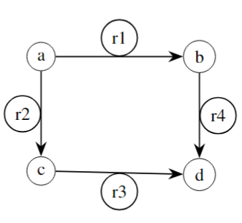
Relational Graphs
A relational graph is defined as a structured, directed graph with multiple labels, represented symbolically as G = (V, E, R) and is used to represent relational data, where :
V is the collection of nodes , each symbolizing an entity.
E represents the collection of directed edges, each annotated with a type of relational label.
R is a a set of labels that classify the types of relationships existing between the entities.
Notes:
The figure on the right is an example of a relational graph G = (V, E, R). Nodes V represent entities (a, b, c, d), edges E represent directed relationships, and labels R denote the types of
relationships (r1, r2, r3, r4). 2.1.2 Role of Relational graphs
Relational graphs offer a significant advantage in reinforcement learning, particularly
in environments where understanding the relationships between entities is critical for effect-
tive decision-making. By representing entities as nodes and their connections as edges with
specific types of relations, relational graphs capture the intricate structure and interactions
within the environment. This approach contrasts with vector-based states, which flatten all
information into a single vector, potentially losing valuable contextual information.
For instance, consider a social network in a multi-agent environment. Here, nodes
represent individual agents, such as users in a social platform, while edges represent rela-
tionships like ”friend”, ”follower”, or ”blocked”. The relational graph explicitly captures
the varying degrees and types of connections, enabling a model to better understand social
interactions, such as the difference between close friendships and mere acquaintances. In
contrast, using vector-based states by representing the environment using vectors would
require encoding each agent and their relationships as a flat vector, which would lose the
explicit relational structure and may obscure the importance of different types of relation-
ships.
Another example could be in the context of hierarchical knowledge representation,
such as in knowledge graphs. Nodes represent entities like people, places, or concepts,
while edges represent relationships such as ”is a”, ”part of”, or ”owned by”. This allows
for an explicit representation of hierarchical and complex relationships, which is crucial
for reasoning about the connections between different entities. A vector-based approach,
on the other hand, would encode each entity and its relationships into a high-dimensional
vector, potentially hiding the structure and making it more challenging to understand the
hierarchy or connections between entities.
In this thesis, relational graphs form the backbone of the input structure upon which
further learning and decision-making processes are built:

Slide 11
Relational Graphs
G = (V, E, R)
V is the set of nodes
E the set of directed edges
R is a a set of relations, associated with edges
(a, R1, b) means entity a stands in relation R1 to entity b
(key, in-front-of, agent)
(Agent, holding, key)
In this thesis, relational graphs form the backbone of the input of the Reinforcement Learning Observation space.
Notes:
The figure on the right is an example of a relational graph G = (V, E, R). Nodes V represent entities (a, b, c, d), edges E represent directed relationships, and labels R denote the types of
relationships (r1, r2, r3, r4). 2.1.2 Role of Relational graphs
Relational graphs offer a significant advantage in reinforcement learning, particularly
in environments where understanding the relationships between entities is critical for effect-
tive decision-making. By representing entities as nodes and their connections as edges with
specific types of relations, relational graphs capture the intricate structure and interactions
within the environment. This approach contrasts with vector-based states, which flatten all
information into a single vector, potentially losing valuable contextual information.
For instance, consider a social network in a multi-agent environment. Here, nodes
represent individual agents, such as users in a social platform, while edges represent rela-
tionships like ”friend”, ”follower”, or ”blocked”. The relational graph explicitly captures
the varying degrees and types of connections, enabling a model to better understand social
interactions, such as the difference between close friendships and mere acquaintances. In
contrast, using vector-based states by representing the environment using vectors would
require encoding each agent and their relationships as a flat vector, which would lose the
explicit relational structure and may obscure the importance of different types of relation-
ships.
Another example could be in the context of hierarchical knowledge representation,
such as in knowledge graphs. Nodes represent entities like people, places, or concepts,
while edges represent relationships such as ”is a”, ”part of”, or ”owned by”. This allows
for an explicit representation of hierarchical and complex relationships, which is crucial
for reasoning about the connections between different entities. A vector-based approach,
on the other hand, would encode each entity and its relationships into a high-dimensional
vector, potentially hiding the structure and making it more challenging to understand the
hierarchy or connections between entities.
In this thesis, relational graphs form the backbone of the input structure upon which
further learning and decision-making processes are built:

Slide 12
Role of Relational Graphs

Slide 13
Graph Convolutional Networks

Slide 14
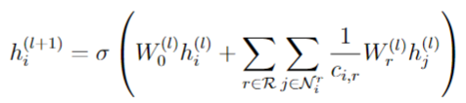
Relational Graph Convolutional Networks(RGCN)
Extension of Graph Convolutional Networks(GCNs), GCNs work well with homogeneous graphs where all edges represent the same type of relationship.However, many real-world graphs are heterogeneous, containing multiple types of relationships.
Relational Graph Convolutional Networks (RGCNs) are message passing frameworks for learning valuable latent features of relational graphs.
The hidden representation of node i at the (l + 1)th layer in R-GCN is given by.
Update rule for Forward pass in RGCNs
Notes:
### Speaker Notes for Relational Graph Convolutional Networks (R-GCNs):
- R-GCNs are an **extension of Graph Convolutional Networks (GCNs)**. While GCNs work well on **homogeneous graphs** (where all edges represent the same type of relationship), many real-world graphs are **heterogeneous** and contain multiple types of relationships.
-R-GCNs handle these **heterogeneous graphs** by learning valuable latent features through a message-passing mechanism.
The hidden representation of a node at layer **(l+1)** in R-GCN is calculated by aggregating information from its neighbors, while accounting for different relationship types between nodes.
RGCNs are widely used for knowledge graphs because knowledge graphs are a specific type of heterogeneous graph with multiple entities and relations. RGCNs capture the diverse relations and interactions in KGs effectively.
Where:
• h(l)
i represents the hidden state of node i at layer l.
• W (l)
0 is the weight matrix for the self-loop (relation of the node with itself).
• R denotes the set of all relation types.
11
• N r
i represents the set of neighboring nodes of node i under relation r.
• ci,r is a normalization constant for relation r.
• W (l)
r is the weight matrix for relation type r.

Slide 15
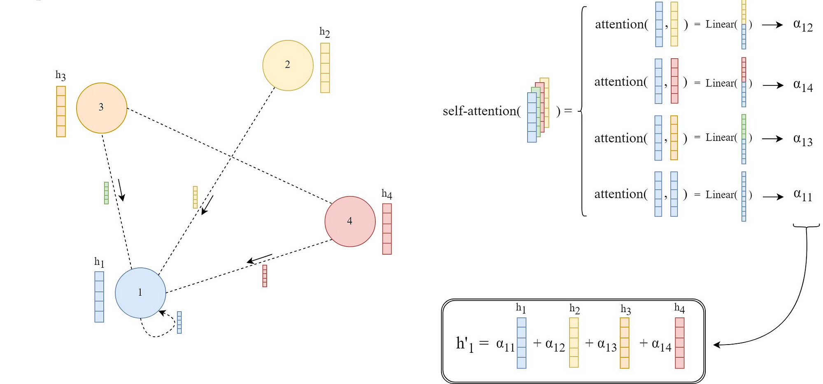
Graph Attention Networks
Graph Attention Networks (GATs) use attention mechanisms to improve feature learning on graphs.
Traditional GNNs like Graph Convolutional Networks (GCNs) treat all neighboring nodes equally when updating a node's features.
GATs assign attention coefficients to each neighbor, emphasizing the most important ones.
This helps nodes focus on relevant neighbors, improving context-sensitive learning and adaptability in the network.
Towards AI. (n.d.). Graph Attention Networks Paper Explained with Illustration and PyTorch Implementation. Towards AI. https://pub.towardsai.net/graph-attention-networks-paper-explained-with-illustration-and-pytorch-implementation-eb35edba562c.
Notes:
Graph Attention Networks (GATs) are an improvement over traditional Graph Neural Networks (GNNs). In GNNs like Graph Convolutional Networks (GCNs), nodes simply average the features of all their neighbors, treating each one equally. This method doesn’t differentiate between more or less relevant neighbors.
GATs, however, introduce an **attention mechanism**. This means each neighbor gets an attention score based on how important it is to the node’s feature update. So, nodes can focus on their most important neighbors, making learning more adaptive and context-aware.

Slide 16
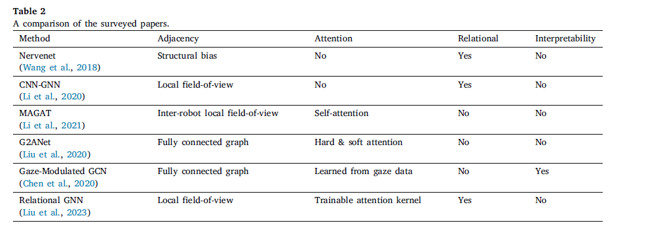
Related Work
NerveNet [Wang et al., 2018]:
Uses GNNs to represent RL policies in MuJoCo environments.
Focuses on node features without explicit relational modeling.
Each node represents a movable part in multi-joint robotic avatars.
Outperforms MLPs in both performance and generalization.
DRL-GAT-SA [Peng et al., 2022]:
Combines graph attention with RL for enhanced situational awareness and safety.
Does not handle dynamic edge weighting or complex relational learning.
Notes:
NerveNet (Wang et al., 2018):
Utilizes Graph Neural Networks (GNNs) to represent reinforcement learning (RL) policies, particularly in MuJoCo environments.
Focuses on node features representing movable parts in robotic avatars but doesn't emphasize relational modeling between nodes.
Outperforms traditional MLPs in both performance and generalization tasks, especially in multi-joint robotic systems.
DRL-GAT-SA (Peng et al., 2022):
Combines graph attention mechanisms with RL to enhance situational awareness and safety.
However, it lacks dynamic edge weighting and does not tackle complex relational learning, limiting its adaptability in highly relational environments.

Slide 17
Methodology

Slide 18

RGCNs Graph Construction
R-GCNs update node features by aggregating transformed features from neighboring nodes based on their relationships.
Nodes incorporate their own features using self-loops, treated separately from other interactions.
In the Grid-to-Graph approach, self-loops are treated like regular edges, with the same relation label, which simplifies node updates.
Grid-to-Graph paper* : Jiang, Zhengyao, et al. "Grid-to-graph: Flexible spatial relational inductive biases for reinforcement learning." arXiv preprint arXiv:2102.04220 (2021).
Notes:
In Relational Graph Convolutional Networks (R-GCNs), each node updates its feature vector by aggregating transformed features from its neighbors, but this aggregation is influenced by the relationships, or edges, connecting the nodes.
A key feature of this process is **self-loops**, where nodes also update based on their own features. Self-loops are usually treated differently from other relational edges.
However, in the **Grid-to-Graph** methodology, self-loops are treated like regular edges, meaning they share the same relation label, simplifying the node update process and allowing a more uniform approach to the aggregation of features.
The equation represents an update rule for node feature vectors in a graph neural network. The updated feature vector yay_aya​ of node aaa is computed by aggregating the feature vectors of its neighbors through a relation type rrr. RRR is the set of all types of relationships, including self-loops, while NraN_r^aNra​ denotes the neighbors connected through relation rrr. Each relation type has a corresponding weight matrix WrW_rWr​. The normalization constant ca,rc_{a,r}ca,r​ controls the effect of node degree, and xbx_bxb​ represents the feature vector of a neighboring node bbb.

Slide 19
Relational Determination Rules
To construct the relational graph, we implement relational determination rules inspired by the methodologies outlined in the Grid-to-Graph paper. Each rule is defined as follows :
r(a,b) condition
where r(a,b) defines a relation from entity a to b with label r, and the condition describes a logical statement that must be true for the relation to be established.
These rules are applied based on the positions and other attributes of the objects, helping the model to understand and encode the spatial and relational structure of the environment effectively.
Notes:
To construct the **relational graph**, we apply **relational determination rules**, inspired by the Grid-to-Graph methodology. These rules define relationships between entities. For example, **r(a, b)** defines a relationship from entity "a" to entity "b," where the label "r" specifies the type of relationship.
Conditions associated with each rule help establish when and how these relationships apply, based on the positions or attributes of objects. This process enables the model to effectively understand and encode the spatial and relational structure of the environment.
The relational rules defined in the system, such as is front, is back, is left, and is right and more, specify conditions under which two objects a and b in a grid environment are related. These rules leverage the spatial positions and other attributes of objects to encode the structure of the environment into a graph model.

Slide 20
Encoding Relational Inductive Biases
The relational rules defined in the system, such as is front, is back, is left, and is right and more, specify conditions under which two objects a and b in a grid environment are related. These rules leverage the spatial positions and other attributes of objects to encode the structure of the environment into a graph model.
For example, the rule:
Notes:
states that object b is considered to be in front of object a if the dot product of the position vector difference (b:pos􀀀a:pos) with a given direction vector direction vec is greater than 0.1. This establishes a ’front’ relationship from a to b, provided the condition is satisfied.
This relational inductive bias assists the model in understanding and predicting actions based on the spatial arrangement of objects, enhancing its generalization capabilities.

Slide 21
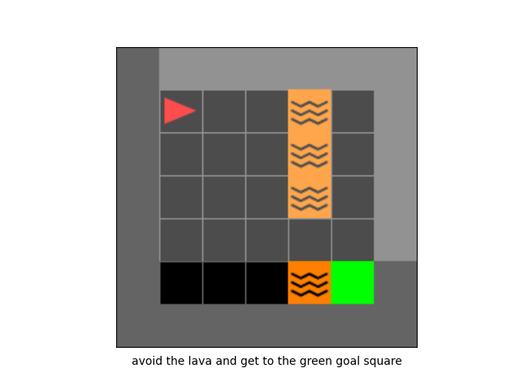
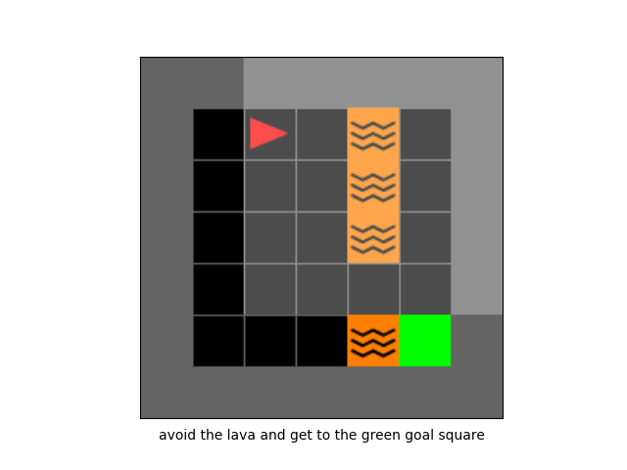
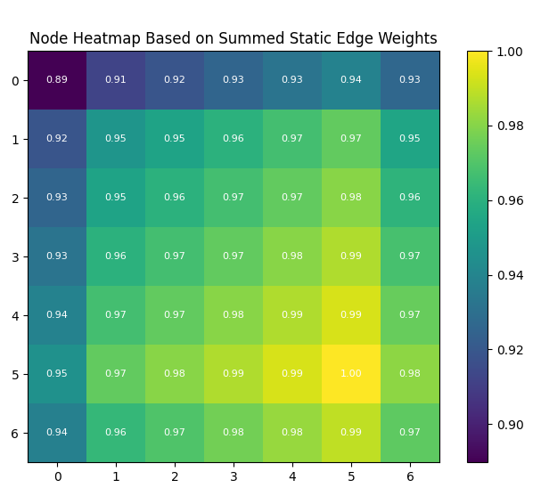
Dynamic Edge Weighting via self-attention
Traditionally, in R-GCNs, the contribution of each neighbour is weighted equally or according to static,predefined parameters.
Initial Environment State at t=0
Environment State at t=1
Notes:
The first figure shows the visual state of the env. And Static Edge Weighting at t=0: Node heatmap illustrating traditional RGCN static weights, highlighting consistent weight distribution across nodes regardless of the agent’s interaction with the environment.
Static EdgeWeighting at t=1: displays static edge weights for the updated state.

Slide 22

New Updated Rule
Once the attention coefficients are determined, they modulate the aggregation of neighbouring features during the convolution operation in RGCNs.
The new Updated Rule after applying dynamic weighting:
Notes:
This modulation allows the network to focus more on the information that is currently most relevant, enhancing the responsiveness of the learning model to changes in the
Environment.
• where : alpha ab denotes the attention coefficient for the edge from node a to node b, which adjusts the contribution of node b’s features based on their relevance, which is derived from the learnable weight from the attention mechanism using from which the attention coefficients are calculated.
• ca;r is the normalization constant for the edge type r at node a, which helps in stabilizing
the learning process.
• Wr represents the weight matrix for edge type r, applied to the features of node b
(xb).
23
• R is the set of all relation types in the graph, with 0 representing the self-loop relation
for incorporating self-features.
• Nr
a is the set of neighbors of node a connected via relation type r.

Slide 23
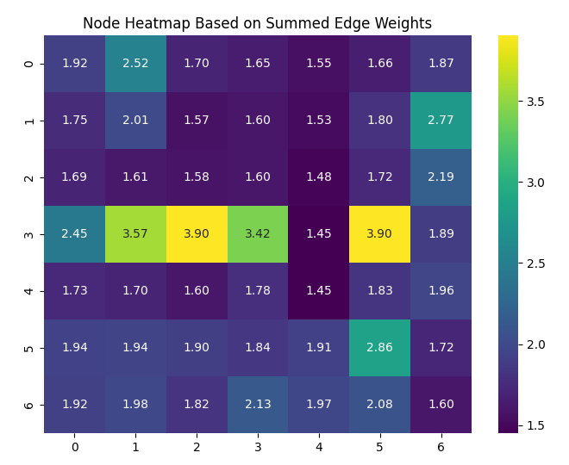
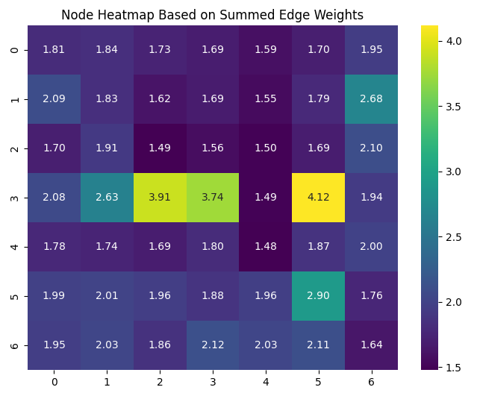
Applying Dynamic Weighting
Initial Environment State at t=0
Environment state at t=1
Notes:
However, such static weighting does not account for the varying relevance of information over different states or stages of learning. To address this, we introduce an attention mechanism that assigns a dynamic weighting to edges based on the current state of the environment and the historical interactions observed by the agent.
The attention coefficients are computed using a pairwise interaction function that considers the features of both the source and target nodes of each edge, as well as the edge’s
existing attributes.
Figure on the right shows the Heatmap showing the weighted significance of node relationships using the REAGLE method, which dynamically adjusts based on the current environmental context and the agent’s position.
Dynamic Edge Weighting at t=1: Similar to Figure 3.4 Continuation of dynamic weight adjustments shown through a heatmap, emphasizing changes in node relationships as the agent progresses and the environment evolves.

Slide 24
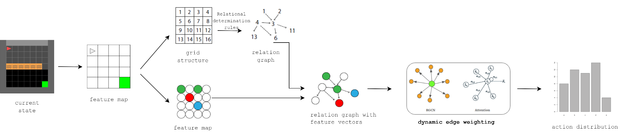
High-level overview of REAGLE
Notes:
We abstract away the grid structure of the feature map and turn observations into a relational graph using relational determination rules. The vectors of the feature map are attached to nodes in the relational graph. We then use an R-GCN to reason over the relational graph and node features, applying dynamic edge weighting with the help of an attention mechanism. This mechanism focuses computation on the most relevant information, thus producing an action distribution.
Refine features further.
Generate policy logits and baseline value.

Slide 25
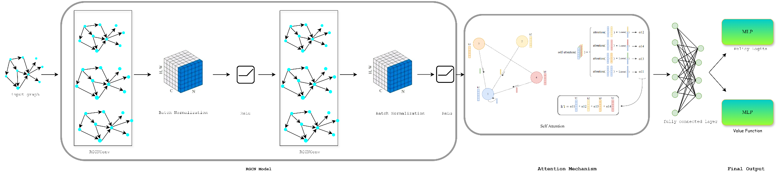
Dynamic Edge Weighting + Graph Attention mechanism
Dynamic Edge Weighting + Graph Attention mechanism
Notes:
Initial State Representation:
Grid world encoded as binary feature vectors.
Feature vectors mapped to nodes in a graph.
Graph Construction:
Use Grid-to-Graph relational rules to establish edges.
Creates a relational graph with node embeddings.
R-GCN Layers:
Project node features to higher-dimensional space.
Two R-GCN layers with distinct relation-specific weights.
Batch normalization after each R-GCN for stability.
Attention Mechanism:
Computes attention coefficients using learnable parameters.
Dynamically scales edge importance based on context.
Dense Layers:
Refine features further.
Generate policy logits and baseline value.
Outcome:
Faster learning, better decision-making, reduced sample complexity.

Slide 26
Experimental Settings

Slide 27
Testing environments
The testing environments have been categorized into four distinct levels of complexity.
Easy.
Medium.
Difficult.
Most Complex.
Notes:
Our research categorizes these environments into four levels of complexity to systematically assess the algorithms’ performance
under different conditions. These environments vary from simple, obstacle-free rooms to
complex scenarios involving multiple tasks and distractors. The primary aim of this structured
categorization is to explore how different RL models adapt to and navigate these
varied settings, focusing particularly on their ability to handle sparse rewards, safe exploration,
and combinatorial decision-making.

Slide 28
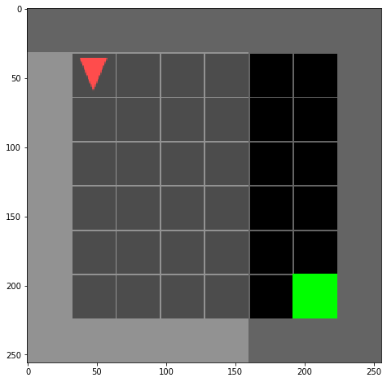
MiniGrid-Empty-6x6-v0 (Easy Environment)
Notes:
The MiniGrid-Empty environment is an empty room with no obstacles involved and the goal of the agent is to reach the green goal square (as seen in figure 4.1), which provides
a sparse reward. A small penalty is applied based on the number of steps taken to reach the goal and the reward is calculated at the end of each episode. This environment is partially
observable, meaning the agent can only see a portion of the environment at any given time, which adds complexity to navigation tasks. This environment is particularly beneficial for
validating your reinforcement learning algorithm in smaller rooms, and for experimenting with sparse rewards and exploration in larger rooms. In the random variants, the agent
starts from a different position each episode, whereas in the regular variants, the agent always begins in the corner opposite the goal.

Slide 29
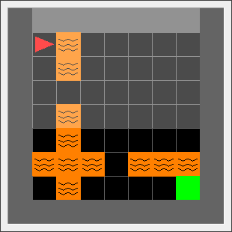
MiniGrid-LavaCrossingS9N2-v0(Medium Environment)
Notes:
This environment is similar to the Lavagap environment but the only difference is it has to cross multiple deadly lava rivers placed vertically and horizontally across the envi-
ronment(as seen in Figure 4.3). For the purpose of this thesis, we selected the environment which had 2 deadly rivers which randomise after every episode. This environment is useful
for studying safety and safe exploration.

Slide 30
MiniGrid-LavaGapS7-v0 (Medium Environment)

Slide 31
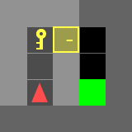
DoorKey Env (Difficult Environment)
Notes:
In the MiniGrid DoorKey environment (as depicted in Figure 4.4), the agent faces the complex task of finding a key to unlock a door, which then allows access to the green goal square. This environment’s partially observable nature adds to the difficulty, as the agent must explore to locate both the key and the door without prior knowledge of their placements. The reward is granted only upon successful completion of the task, with penalties for each step taken to encourage efficient exploration and problem-solving. This scenario is particularly useful for examining advanced learning strategies like curiosity-driven learning
or curriculum learning in reinforcement learning frameworks.

Slide 32
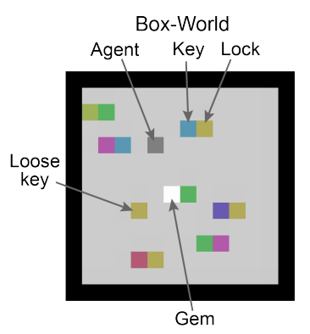
Boxworld (Most Complex Environment)
Notes:
Box-world, a grid-world navigation challenge introduced by , requires an agent to collect a gem using the appropriate key. This key is secured within a locked box that can only be opened using another distinct key. The game features distractor branches that can mislead the agent by consuming the current key and yielding another key, which does not unlock the gem box. Due to its combinatorial complexity, the probability of randomly stumbling upon the correct solution is minimal. Zambaldi et al. reported that their reinforcement learning (RL) models needed between 200 million to 1.4 billion steps to achieve convergence in this environment.
Given our limited computational resources, our models are trained for only 1.8 million steps in each setting. We also simplify the \textbf{Box-World} environment to manage complexity: we reduce the field size to 10x10, limit the number of distractor branches to one, shorten the length of distractor branches to one, and set the goal length to two. While these modifications lower the game's difficulty, they maintain the fundamental elements of the Box-World environment, allowing us to still evaluate the relational reasoning capabilities of various models effectively while reducing the total training steps required for convergence.

Slide 33
Experimental Results

Slide 34
Experimental Results
We make use of IMPALA,a policy-gradient algorithm to train the RL models and which is also responsible for the action distribution.
We assess the effectiveness of our approach against the following well-established Graph Neural Network(GNN) models.
Graph Attention Network (GAT)
Graph Convolutional Network (GCN)
Vanilla Relational Graph Convolutional Network (RGCN)

Slide 35
Training Performance Evaluation
We designed three measurement metrics to access the sample complexity as follows :
Mean Episode Return
Total Number of Episodes or Timesteps
Asymptotic Performance
Notes:
To investigate the training performance of our methodology, we conducted a series of experiments using a carefully designed setup. First, to evaluate the training performance
concerning the mean episodic return, we performed training sessions using our method, REAGLE, along with other baseline methods. To enhance the reliability of our results, each experiment was run five times and then taken average of it. This practice is common in the reinforcement learning domain as it helps mitigate the effects of random initialization and other stochastic factors inherent in such experiments, ensuring that the reported outcomes are not unduly influenced by any single run. Following the completion of each experiment, the rewards from all episodes were averaged to compute the mean reward for that run. The final reported performance for each experiment is thus derived from the average of these mean rewards across all five runs, providing a robust measure of the training performance of the various methods evaluated.
Mean Episode Return: The learning curve plots the performance of the algorithm over time or episodes. We plot the mean episode return of the models
Total Number of Episodes or Timesteps: This metric helps us to count the total number of episodes or timesteps required for the algorithm to reach a certain level of performance or to converge to an optimal or near-optimal policy.
Asymptotic Performance: This is the performance level achieved after a large number of samples, indicating the long-term effectiveness of the algorithm.

Slide 36
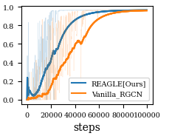
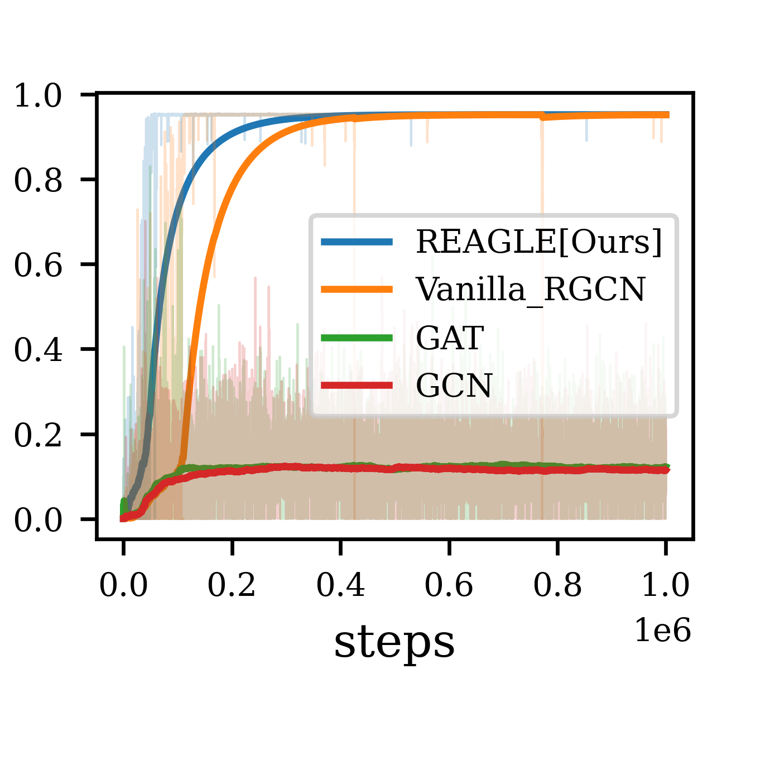
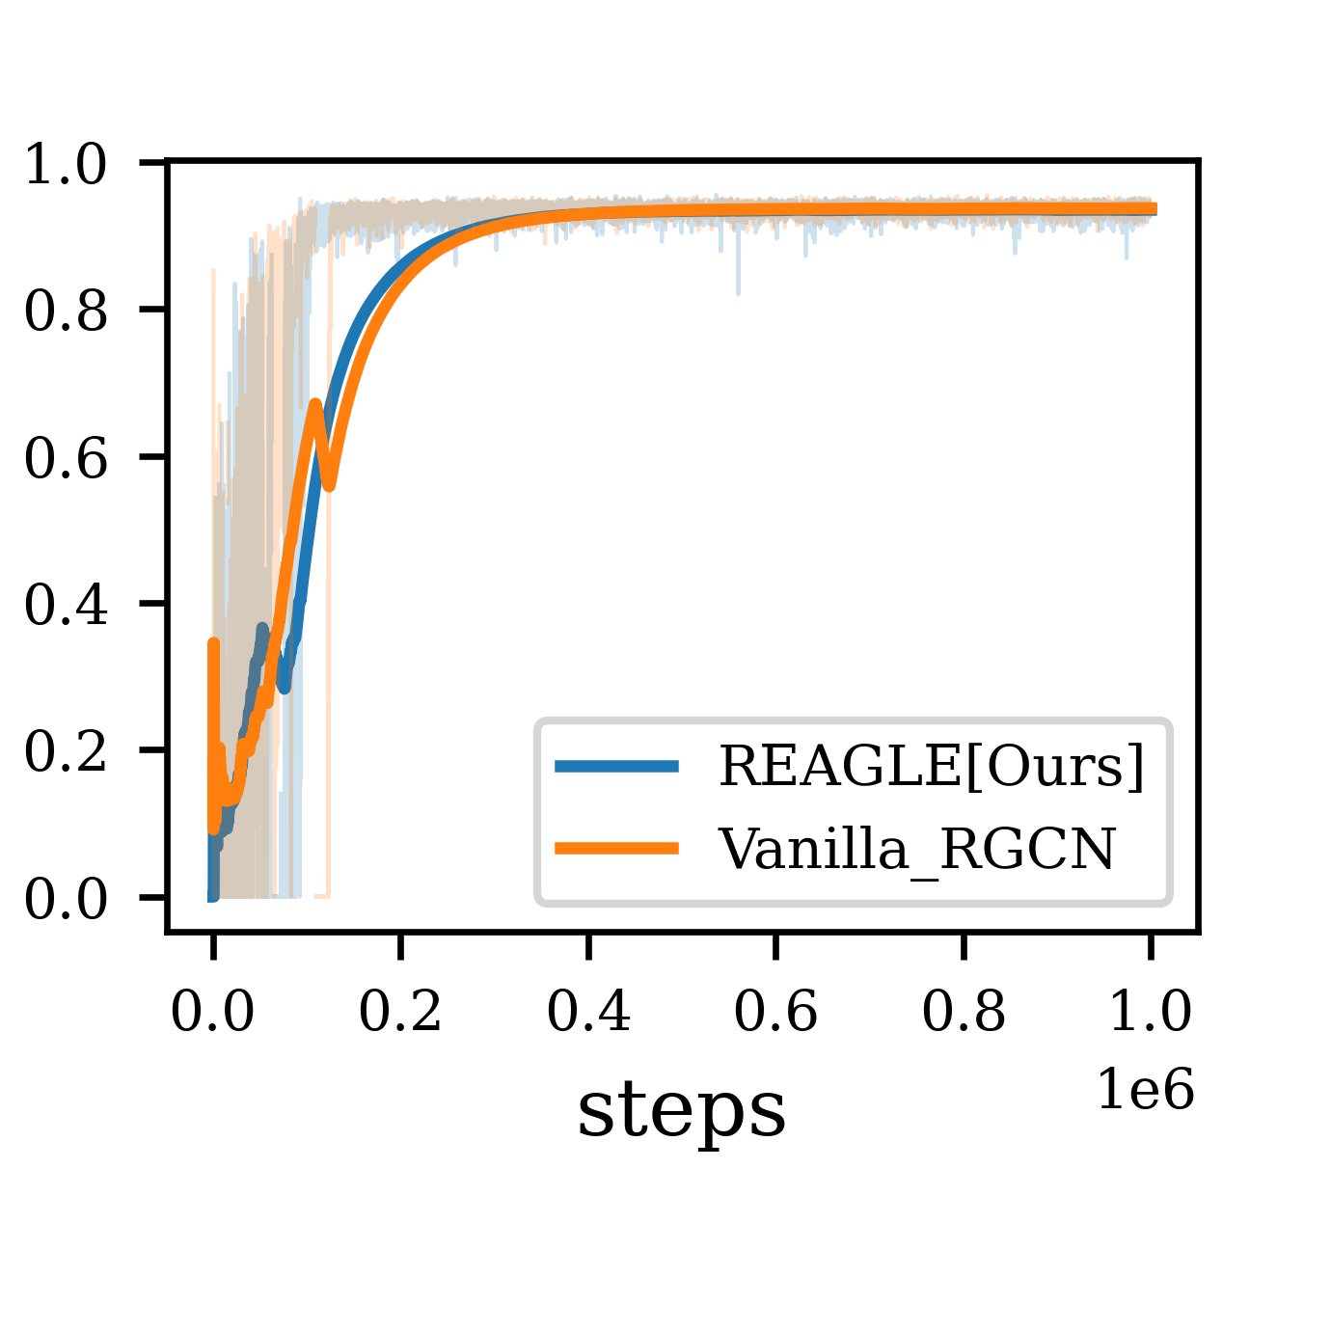
Minigrid Environment Results
Fig 6.1 Training curves of REAGLE and the baseline approach in the Minigrid Lava Crossing environment.
Fig 6.2 Training curves of our method and the baseline approaches in the
MiniGrid-LavaGapS7-v0 environment
Fig 6.3 Training curves of our method and the baseline approach in the
MiniGrid-DoorKey-5x5-v0 environment
Notes:
Fig 6.1 : As seen in Figure 5.1, for the Minigrid-Lavacrossing environment, our model consistently outperforms the vanilla method when trained for 100k steps. Both REAGLE and Vanilla RGCN start with low initial performance but show rapid improvement in the early stages. As the number of steps increases beyond 40,000, both models begin to plateau, with
REAGLE stabilizing at a higher mean return close to 1.0, while Vanilla RGCN stabilizes slightly below that, around 0.9. REAGLE converges around 65,000 steps, and compared to Vanilla RGCN, which converges around 85,000 steps, our method achieves higher performance in fewer steps. This indicates that our approach is more sample-efficient, making it
more suitable for scenarios where training time is limited.
In the MiniGrid-LavaGapS7-v0 environment, we trained our model REAGLE for 1 million steps and compared its performance against baseline models Vanilla RGCN, GAT, and GCN (as seen in Figure 5.2). REAGLE showed better sample complexity, achieving a mean episodic return of 0.95 after approximately 250,000 steps. In contrast, Vanilla RGCN required about 400,000 steps to reach the same performance level, making REAGLE more efficient. GAT and GCN performed poorly, plateauing at a much lower mean episodic return of around 0.2, indicating their struggles with the task complexity.
For the MiniGrid-DoorKey-5x5-v0 environment (as seen in Figure 6.3), we observed that both REAGLE and the vanilla model respectively show rapid convergence, achieving
approximately 85% of their maximum performance within the first 100,000 steps. Notably, the REAGLE model reached a mean episodic return of 0.85 at around 50,000 steps,
whereas Vanilla RGCN achieved similar performance at approximately 60,000 steps, indicating that REAGLE converges slightly faster with a 10,000-step advantage. As training
continued, both models plateaued at a high-performance level close to a mean episodic return of 1.0, with both REAGLE and Vanilla RGCN ultimately converging to approxi-
mately 0.98. This demonstrates that both models are equally effective in optimizing for the Lavagap environment. The stability of performance, particularly after 200,000 steps, was
also noteworthy, with REAGLE exhibiting slightly lower variance and maintaining a more stable performance curve compared to Vanilla RGCN. This enhanced stability suggests
that REAGLE may offer more consistent results across different training runs, making it particularly valuable in scenarios where reliable agent behavior is crucial. Overall, while
both models achieve comparable asymptotic performance, REAGLE’s slight edge in convergence speed and performance stability could make it a more attractive option, especially
in environments where early learning efficiency and consistency across runs are essential.

Slide 37
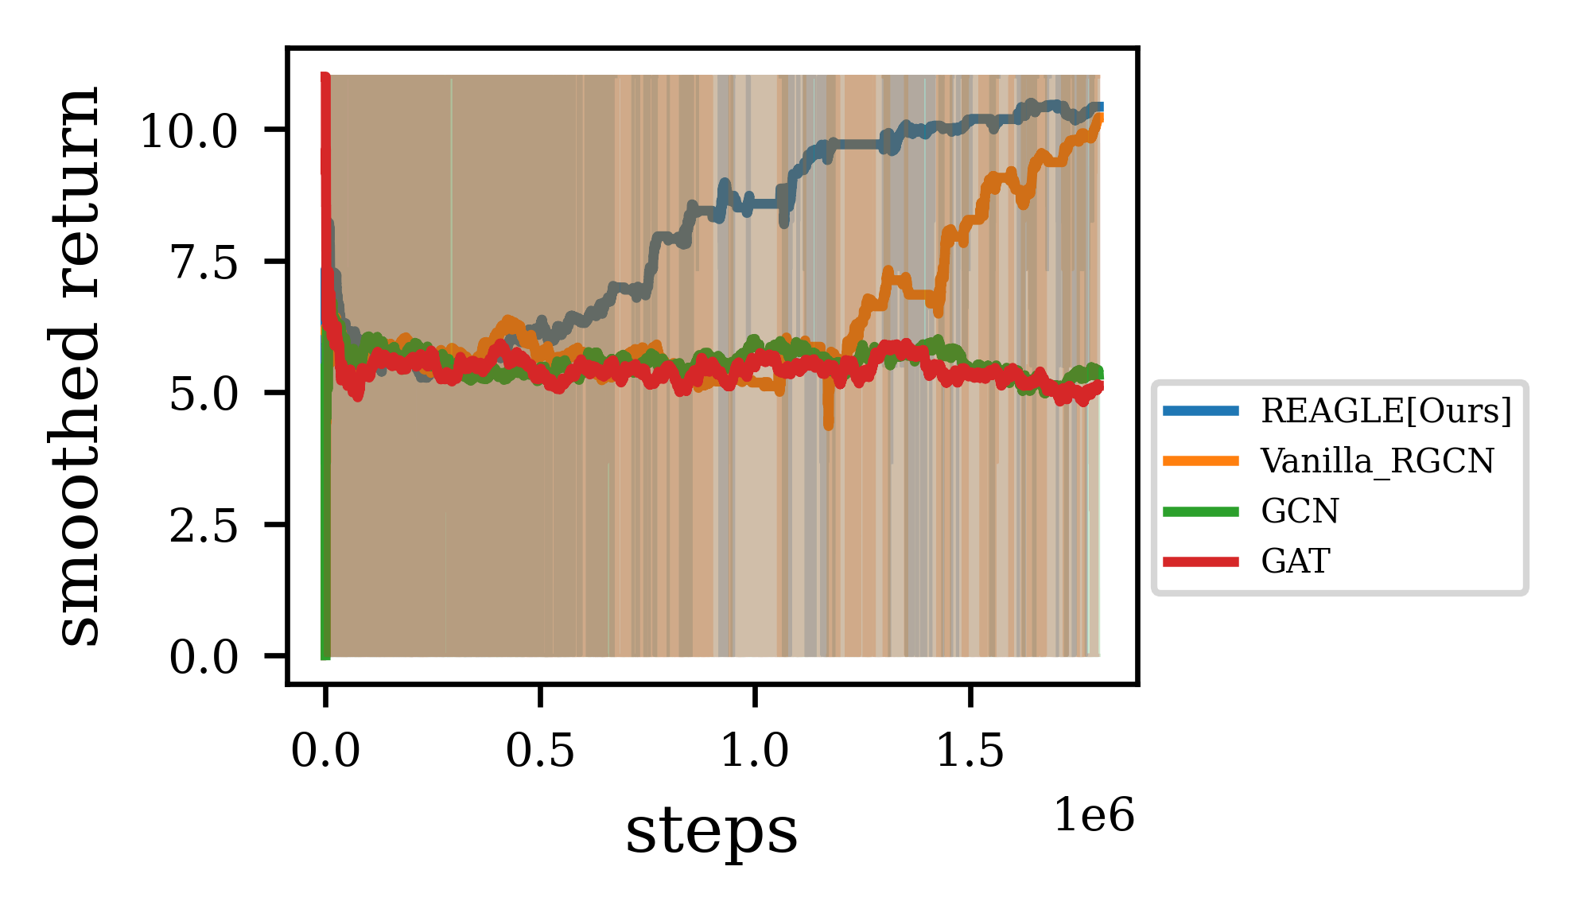
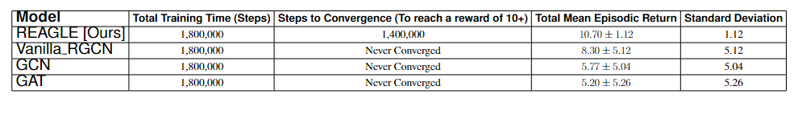
Boxworld Environment Results

Slide 38
Conclusion
We presented a approach to enhance sample efficiency in reinforcement learning by dynamically weighting the edges in Relational Graph convolutional Networks (R-GCN) using Graph Attention Networks (GAT) called REAGLE.
Enhances sample efficiency by prioritizing important relationships and edges.
Achieves higher mean episodic returns.
Faster convergence than baseline models.
Reduces sample complexity in complex environments.
Notes:
We presented an approach to enhance sample efficiency in reinforcement learning by dynamically weighting the edges in Relational Graph Convolutional Networks
(R-GCN) using Graph Attention Networks (GAT). Our method, named REAGLE, demonstrated improved performance and efficiency in various complex environments compared
to baseline models. The dynamic edge weighting allows the model to adapt more rapidly to the changing importance of relationships within the environment, focusing computational
resources on the most relevant information and thus accelerating the learning process.Our experiments across different levels of complexity in simulation environments have
shown that REAGLE can achieve higher mean episodic returns and converge faster than traditional models. This indicates a significant reduction in the sample complexity required
to train effective reinforcement learning agents on relational domains. The integration of GAT within R-GCN provided the necessary flexibility and focus, enabling the agent to prioritize crucial information dynamically.

Slide 39
Thank You

